Slide 1
CS4320TU Applied AI Project
· Project Background
· Project Goal
· Approach Design
· Current Progress
· Future Plan
Imitation Learning for Skill Transfer in Human-Robot Teleoperation
Group Member:
Marco Schouten (5352908)
Chenghao Xu (5266068)
Supervisor:
R Venkatesha Prasad
Vineet Gokhale
Ashutosh Simha

Slide 2
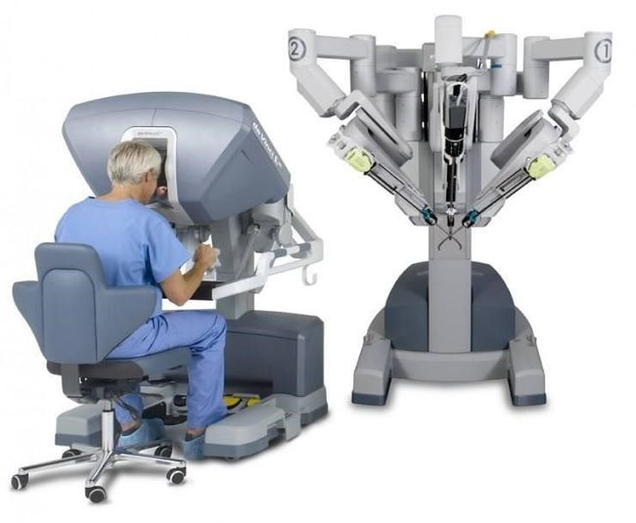
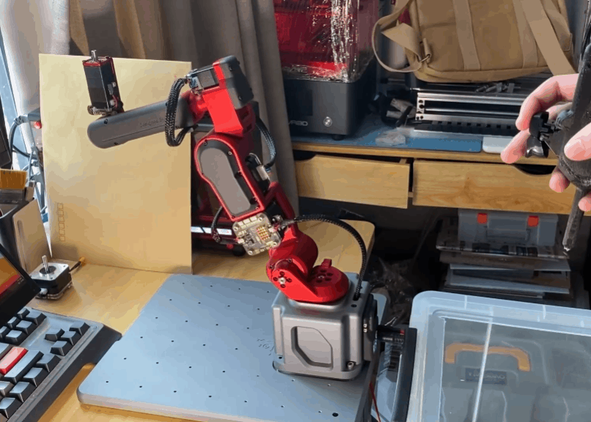
Project Background
With the rapid development of 5G technology，teleoperation could perform remote control to operate the robot at a remote distance. Meanwhile, Users expect that the robot can perform similar actions as precisely as human.
Applications:
Service Robot; Biped Robot; Surgery Robot;
Main Problem:
Transmission time delay
Transmission data size
· Project Background
· Project Goal
· Approach Design
· Current Progress
· Future Plan
Fig 1. the Surgery Performed by Da Vinci Robot
Fig 2. Imitation Learning for Human-robot Interaction

Slide 3
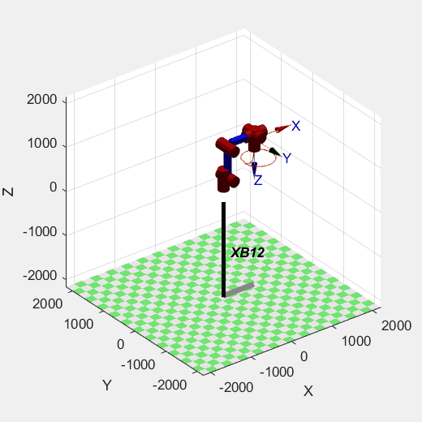
Project Goal
As for the various human action, develop an AI model to learn the specific trajectories of human arm, then regenerate the similar trajectories by robot using minimal representation inputs.
· Project Background
· Project Goal
· Approach Design
· Current Progress
· Future Plan
Kinect Camera records human actions
Model the input angle data encoder in joint space
Model the robot trajectory decoder in cartesian space
Develop the trajectory comparison metric
Fig 3. example for 6-axis Industrial Robot
Control interval: 1 ms = 0.001 s
Number of control input: 6
Reproduce the trajectory in the past 1 s:
6000 float number data
force data & torque data

Slide 4
Approach Design
Solution is a two-fold
(A) compact encoding to represent trajectory
(B) probabilistic model that generate new trajectory
· Project Background
· Project Goal
· Approach Design
· Current Progress
· Future Plan

Slide 5
Trajectory encoding: GMM-GMR
Calinon et al. 2015 approached skill encoding as a clustering problem. Instead of modeling the regression function directly, they estimate a joint-distribution over the state variables, and perform regression through conditioning.
During reproduction, the motion is retrieved through statistical inference using Gaussian Mixture Regression (GMR).
· Project Background
· Project Goal
· Approach Design
· Current Progress
· Future Plan
Notes:
Then, Gaussian Mixture Regression (GMR) was used to retrieve a generalized version of the trajectories either in joint space (characterized by a set of postures changing through time) [3], or in task space (characterized by the 3D Cartesian position of the hand relative to the objects in the scene) [2]

Slide 6
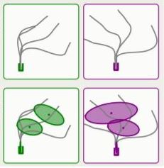
Conceptual Description (1)
· Project Background
· Project Goal
· Approach Design
· Current Progress
· Future Plan
Data is encoded using Gaussian Mixture Model (GMM), which approximates the joint Probability density function
P(X, t)
TASK1 TASK2

Slide 7
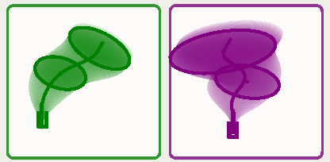
Conceptual Description (2)
Compute, with GMR, a tube of Gaussians for each reference frame “conditioning”
P(X | t)
· Project Background
· Project Goal
· Approach Design
· Current Progress
· Future Plan

Slide 8
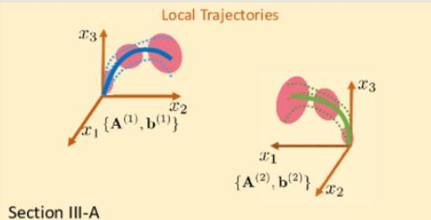
Approach Design summary
· Project Background
· Project Goal
· Approach Design
· Current Progress
· Future Plan

Slide 9
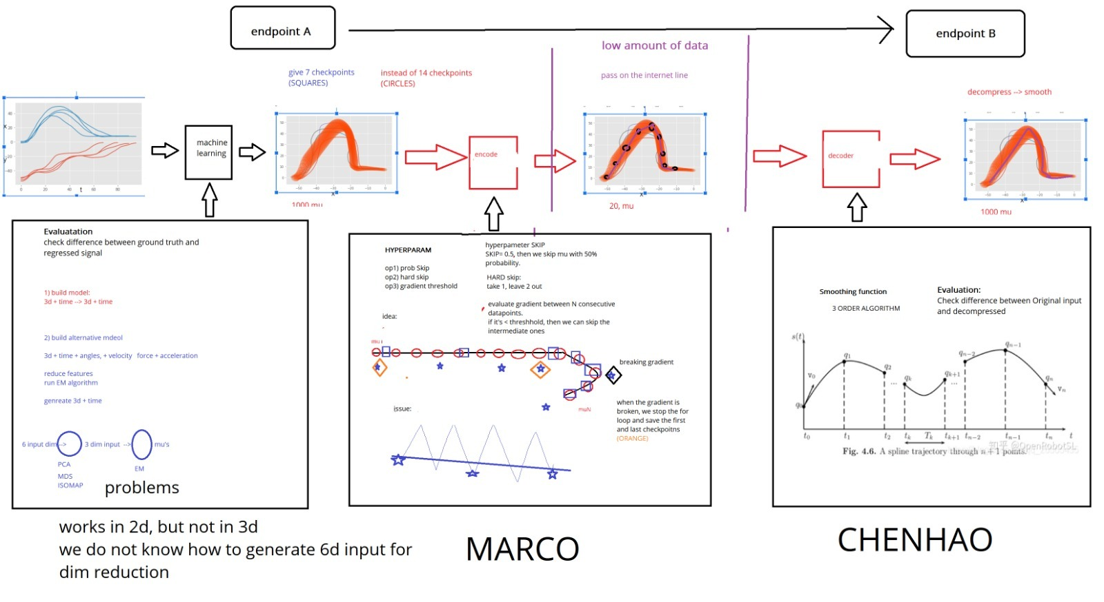
· Project Background
· Project Goal
· Approach Design
· Current Progress
· Future Plan
Notes:
EM maximization initialized with K-means
unobserved variable is the gaussian that generated the observation.

Slide 10
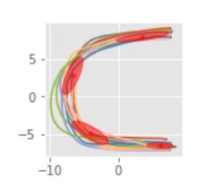

GMM
Training with Expectation Maximization algorithm
tested on a 2D space
Gesture detection on Kinect
· Project Background
· Project Goal
· Approach Design
· Current Progress
· Future Plan
Notes:
EM maximization initialized with K-means
unobserved variable is the gaussian that generated the observation.

Slide 11
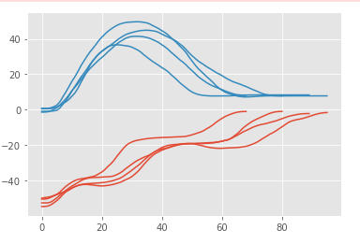
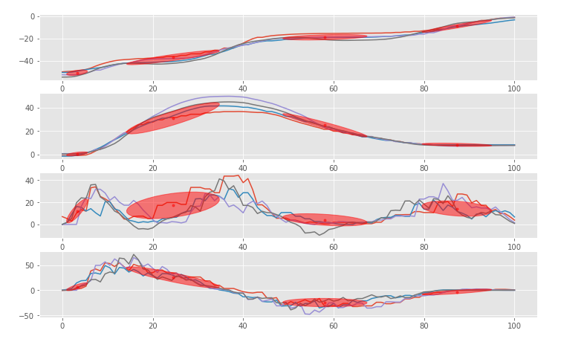
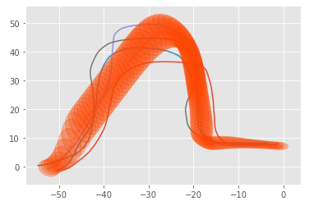
GMR
x
x
y
· Project Background
· Project Goal
· Approach Design
· Current Progress
· Future Plan
v_x
y
v_y
t
t
y
x

Slide 12
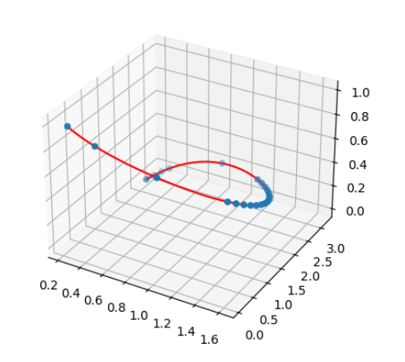
Compression (encoder)
core idea:
checks gradients between consecutive points
safety: do not skip more than x% of the points (prevents too long straight lines)
hyper-parameters:
threshold (for gradient check)
skip percentage
extensions: probabilistic approach
determine a function that returns the probability of skipping according to the gradients, and skip percentage threshold
· Project Background
· Project Goal
· Approach Design
· Current Progress
· Future Plan
x1: x, x2: y, time: z
Notes:
EM maximization initialized with K-means
unobserved variable is the gaussian that generated the observation.

Slide 13
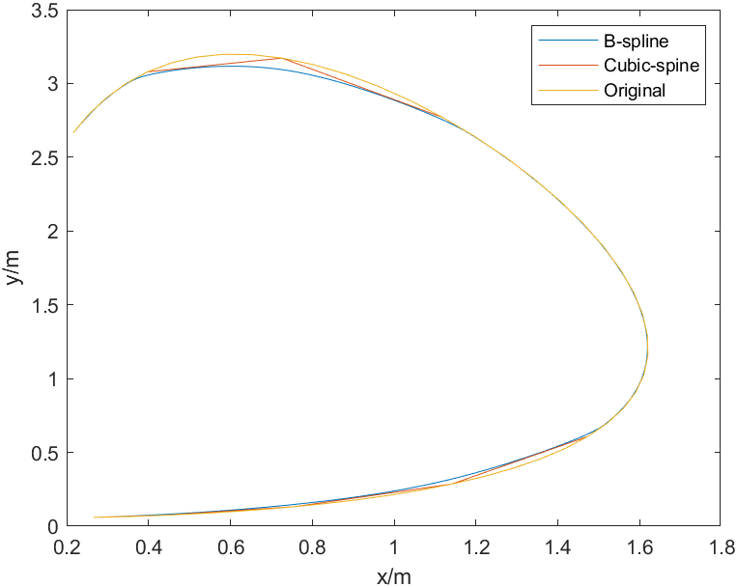
Compression (decoder)
core idea:
B-spline algorithm
Cubic-spline algorithm
· Project Background
· Project Goal
· Approach Design
· Current Progress
· Future Plan
x1: x, x2: y
Notes:
EM maximization initialized with K-means
unobserved variable is the gaussian that generated the observation.

Slide 14
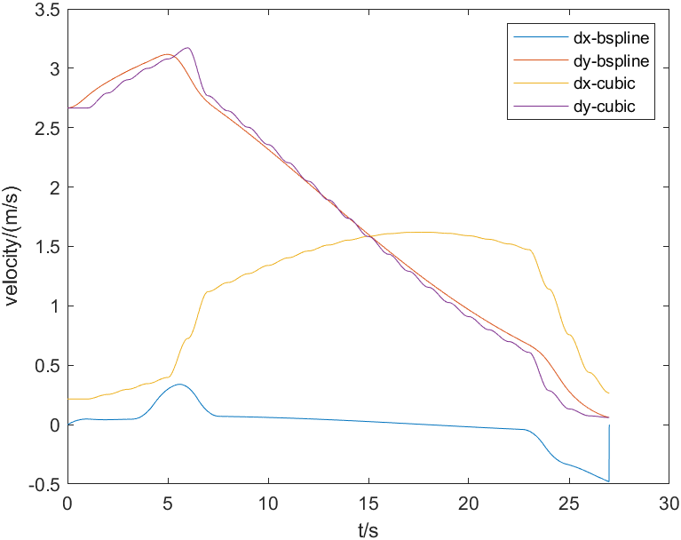
Compression (decoder)
core idea:
B-spline algorithm
Cubic-spline algorithm
· Project Background
· Project Goal
· Approach Design
· Current Progress
· Future Plan
x1: time, x2: velocity
Notes:
EM maximization initialized with K-means
unobserved variable is the gaussian that generated the observation.

Slide 15
Machine Learning Black Box
dictionary of 2 task
learn each task with 10 demonstrations.
1) spatial alignment (if demostration have different number of points)
2) initialzie GMM model with ScikitLearn Baesian Miexture
3) fit using Expectation Maximization (HYPERPARAMETRS)
4) execute conditioning operation to retrieve the trajectory
· Project Background
· Project Goal
· Approach Design
· Current Progress
· Future Plan
Notes:
EM maximization initialized with K-means
unobserved variable is the gaussian that generated the observation.

Slide 16
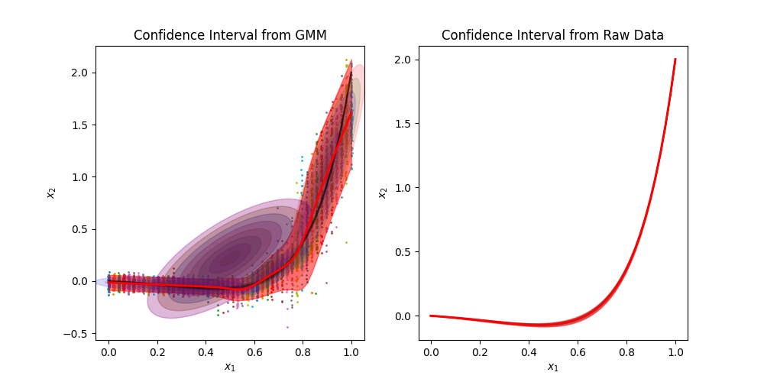
GridSearch For hyper param tuning
· Project Background
· Project Goal
· Approach Design
· Current Progress
· Future Plan
x1: time, x2: velocity
TOO MANY
5 COMPONENTS,
Notes:
EM maximization initialized with K-means
unobserved variable is the gaussian that generated the observation.

Slide 17
Dictionary
· Project Background
· Project Goal
· Approach Design
· Current Progress
· Future Plan
task 1: lift up arm
task 2: extend arm
Notes:
EM maximization initialized with K-means
unobserved variable is the gaussian that generated the observation.

Slide 18
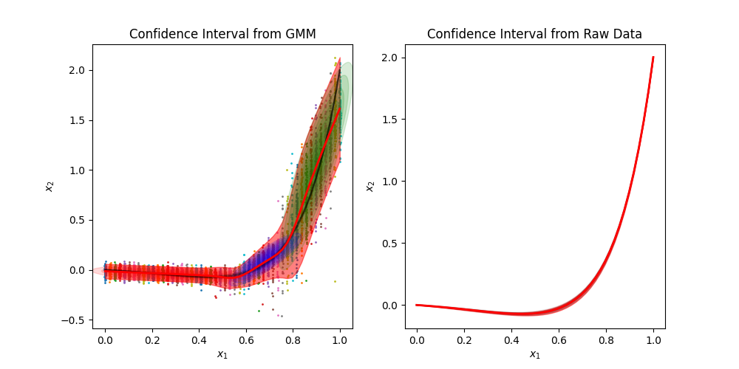
task 1, lifting up object
· Project Background
· Project Goal
· Approach Design
· Current Progress
· Future Plan
x1: time, x2: velocity
3 COMPONENTS,
Notes:
EM maximization initialized with K-means
unobserved variable is the gaussian that generated the observation.

Slide 19
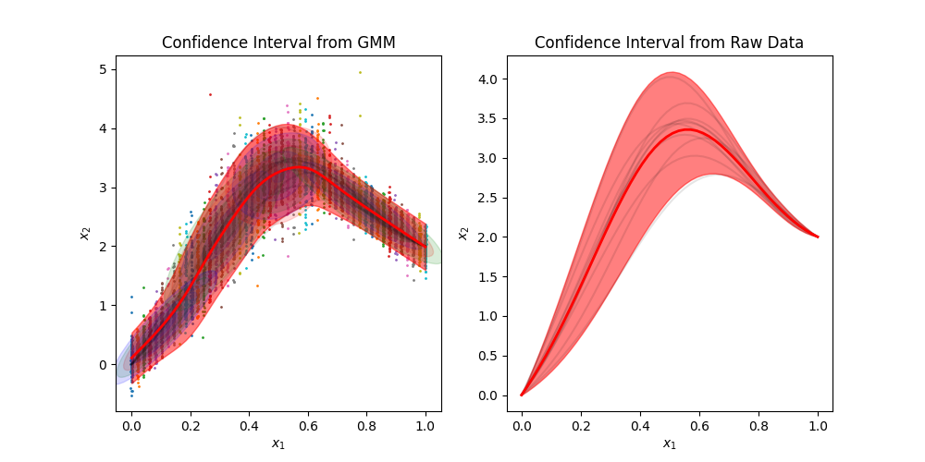
task 2 arm extension
· Project Background
· Project Goal
· Approach Design
· Current Progress
· Future Plan
x1: time, x2: velocity
Notes:
EM maximization initialized with K-means
unobserved variable is the gaussian that generated the observation.

Slide 21
What we accomplished this week
(A) Use Linux to implement Kinect Sensor
(B) Generate the performance from trajectories and use Grid-Search for hyperparameter tuning
(C) add action (task) library
If time permits
(D) smatirt encoding of trajectories combine acceleration and angles info with Dim-reducon
(E) investigating different initialization approaches - Bayesian model that incorporate priors - k-means)
· Project Background
· Project Goal
· Approach Design
· Current Progress
· Future Plan

Slide 22
Task Parametrization
achieves strong context adaptation by representing task motion in local coordinate systems. It observes demonstrations from different perspectives.
Requires three elements:
a context parameterization which defines the relation between local (context-independent) coordinate systems, and a global coordinate system;
a model parameterization to compactly represent the local movement representations;
merging method that allows to fuse the contextualized movement representation (product of gaussians must be defined)
· Project Background
· Project Goal
· Approach Design
· Current Progress
· Future Plan
Notes:
The linear transformation properties of the Gaussian Mixture Model (GMM) allow the modeling of primitives in different coordinate systems.
By relating coordinate systems to the task context (e.g. objects or landmarks), a context-adaptive version of GMM-GMR, named Task-Parameterized GaussianMixtureModel (TP-GMM), is realized.

Slide 23
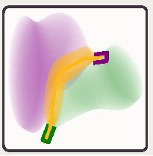
TP
· Project Background
· Project Goal
· Approach Design
· Current Progress
· Future Plan
Add conditioning → one model can retrieve several tasks.
how? first by projecting the reference frames to the global frame, than computing the product of Gaussians to retrieve the gold trajectory

Slide 24
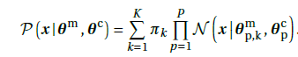
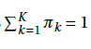
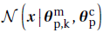
Task Parametrization GMM
· Project Background
· Project Goal
· Approach Design
· Current Progress
· Future Plan
sum of K distribution with weights s.t.
Each distribution is a product of P Gaussians, each representing the task in a local coordinate systems
defined by:
context parameters
model parameters

Slide 25
Week 3 | Install the coppeliaSim platform √ Search for relevant literature √ Write down the goal of the project √
Week 4 | Complete searching for literature √ AI concept design for the project √ Pick up Kinect, learn how Kinect works √
Week 5 | Initiate decision for AI model √ Start learning how to collect data √ Pick up the initial kinematic data √
Week 6 | Accomplish dimension reduction and Gaussian model, and plot the data in the feature space √ Prepare for the mid-term presentation √ Generate fake data of human arm action √
Week 7 | Learn GMR for the reproduction and segmentation Accomplish the GMR coding part to regenerate trajectory Realize the Kinect human action record and angle reflection
Week 8 | Improve the model design and tune hyperparameters Work on performance evaluation and establish of action library
Week 9 | Summary and evaluate the result Finish the project report
· Project Background
· Project Goal
· Approach Design
· Current Progress
· Future Plan

